Slide 1

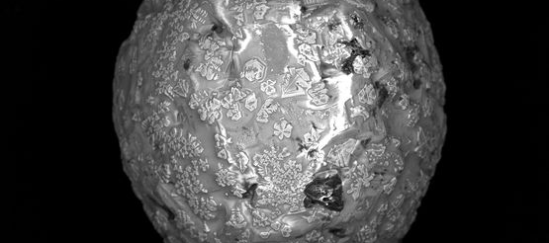
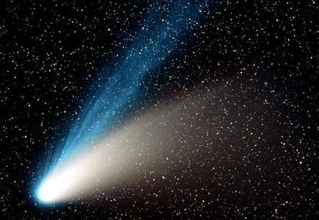
SPCE 5065 MICRO-METEROIDS design solutions Week 5 – mmod part 2

Slide 2
introduction
Meteroids
Meteors
Meteorites
Micrometeriods (MM)

Slide 3
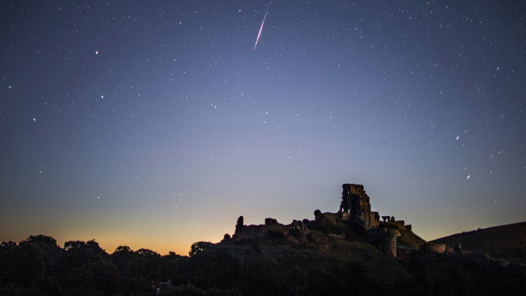
METEOR SHOWERS

Slide 4
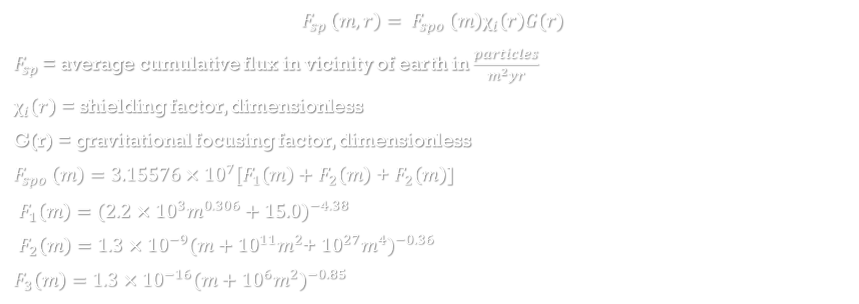
Sporadic Meteoroid models
$$F_{sp }\left(m,r\right)= F_{spo }\left(m\right)χ_{i}\left(r\right)G(r)$$
$F_{sp }$= average cumulative flux in vicinity of earth in $\frac{particles}{m^{2}yr}$
$χ_{i}\left(r\right)$ = shielding factor, dimensionless
G(r) = gravitational focusing factor, dimensionless
$F_{spo }\left(m\right)=3.15576×{10}^{7}[F_{1}\left(m\right)+$ $F_{2}\left(m\right)$ + $F_{2}\left(m\right)$]
$F_{1}\left(m\right)=(2.2$ $×{10}^{3}m^{0.306}+15.0)^{−4.38}$
$F_{2}\left(m\right)=1.3$ $×{10}^{−9}(m+{10}^{11}m^{2}$+ ${10}^{27}m^{4})^{−0.36}$
$F_{3}\left(m\right)=1.3$ $×{10}^{−16}(m+{10}^{6}m^{2})^{−0.85}$

Slide 5
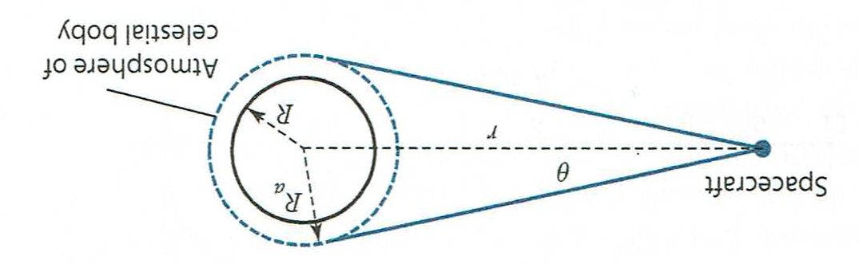
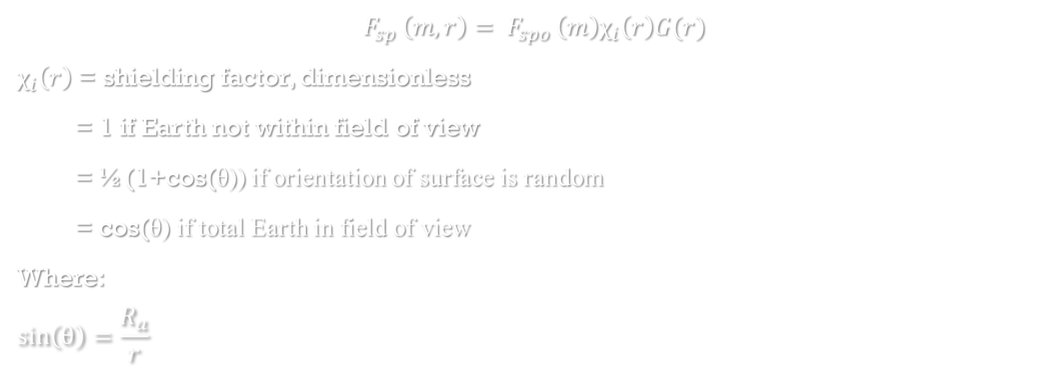
Sporadic Meteoroid models
$$F_{sp }\left(m,r\right)= F_{spo }\left(m\right)χ_{i}\left(r\right)G(r)$$
$χ_{i}\left(r\right)$ = shielding factor, dimensionless
= 1 if Earth not within field of view
= ½(1+cos(θ)) if orientation of surface is random
= cos(θ) if total Earth in field of view
Where:
$$\sin\left(θ\right)=\frac{R_{a}}{r}$$

Slide 6

Sporadic Meteoroid models
$$F_{sp }\left(m,r\right)= F_{spo }\left(m\right)χ_{i}\left(r\right)G(r)$$
G(r) = gravitational focusing factor, dimensionless
$$G\left(r\right)=1+\frac{R_{a}}{r}$$

Slide 7
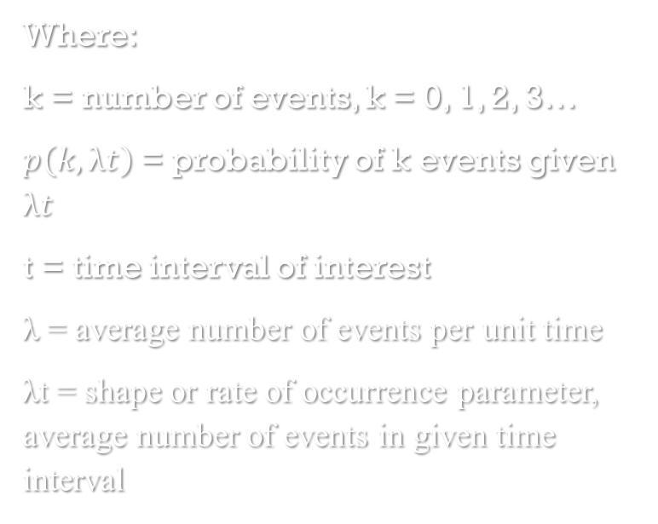
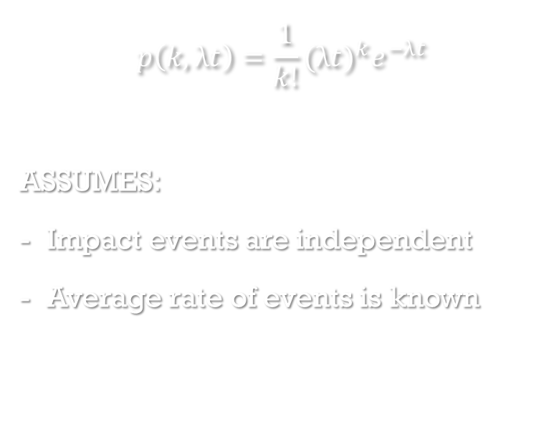
COLLISION PROBABILITIES
$$p\left(k, λt\right)=\frac{1}{k!}{(λt)}^{k}e^{−λt}$$
ASSUMES:
Impact events are independent
Average rate of events is known
Where:
k = number of events, k = 0, 1, 2, 3…
$p\left(k, λt\right)$ = probability of k events given $λt$
t = time interval of interest
λ = average number of events per unit time
λt = shape or rate of occurrence parameter, average number of events in given time interval

Slide 8
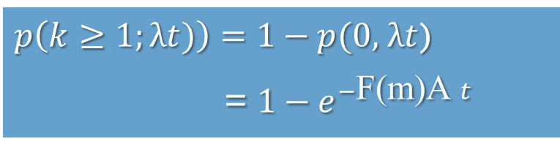

COLLISION PROBABILITIES
PROBABILITY OF ONE OR MORE EVENTS OCCURING
$p\left(k≥1;λt)\right)=1−p(0,$ $λt$)
= ${1−e}^{−λt}$
$p\left(k≥1;λt)\right)=1−p(0,$ $λt$)
= ${1−e}^{−\text{F}\text{(}\text{m}\text{)}\text{A} t}$
Where:
λ = average number of events per unit time
λ = F(m)A
F(m) = average flux density for mass > m, particles per unit time per unit area

Slide 9
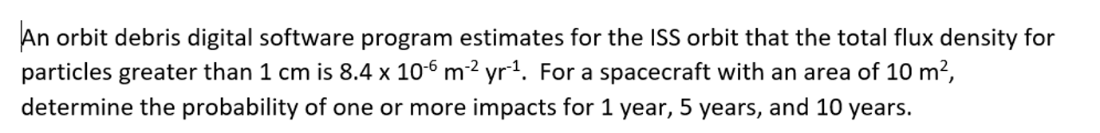
EXAMPLE

Slide 10
HOMEWORK 5
5. Compare the likelihood of satellites in typical orbits of being impacted by micrometeroids.
a. Plot the flux density for micrometeroids with masses ranging from 10⁻⁵g to 10 g for the ISS, GPS and a GEO satellite on the same plot.
b. How much average time (in years) will there be between events (collisions) with probabilities greater then 0.01% for each orbit for micrometeroids of 0.1 cm, 1 cm, and 10 cm? Assume the satellite has an area of 10 m².
c. What can you conclude about the likelihood of damage to satellites with an expected mission life of 10 years?

Slide 11
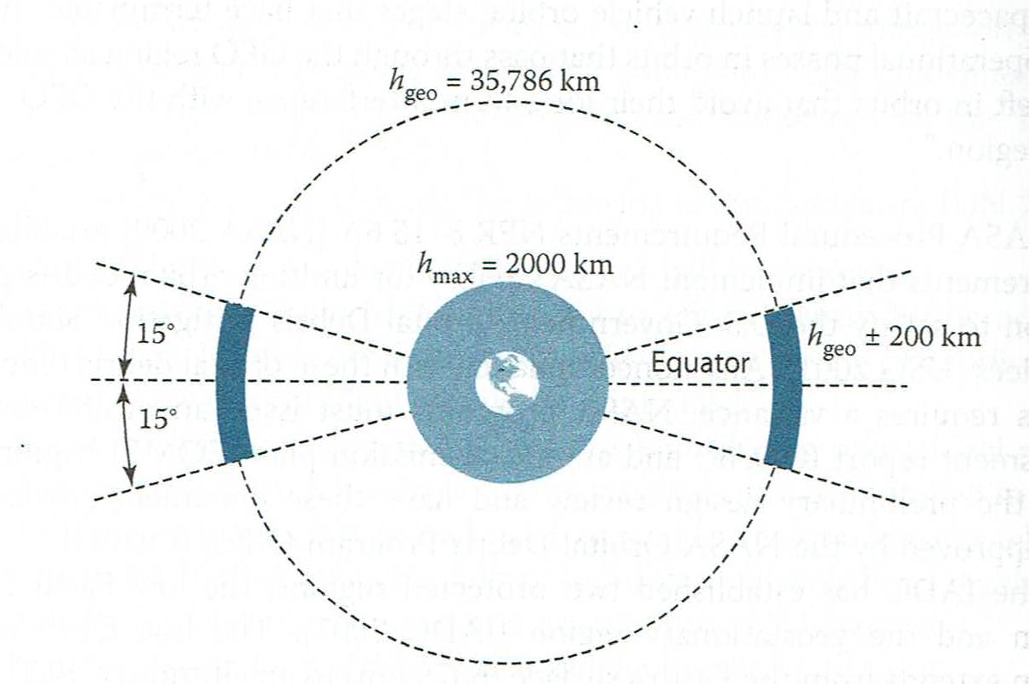
Inter-agency space debris coordination committee (iadc) - protected regions

Slide 12
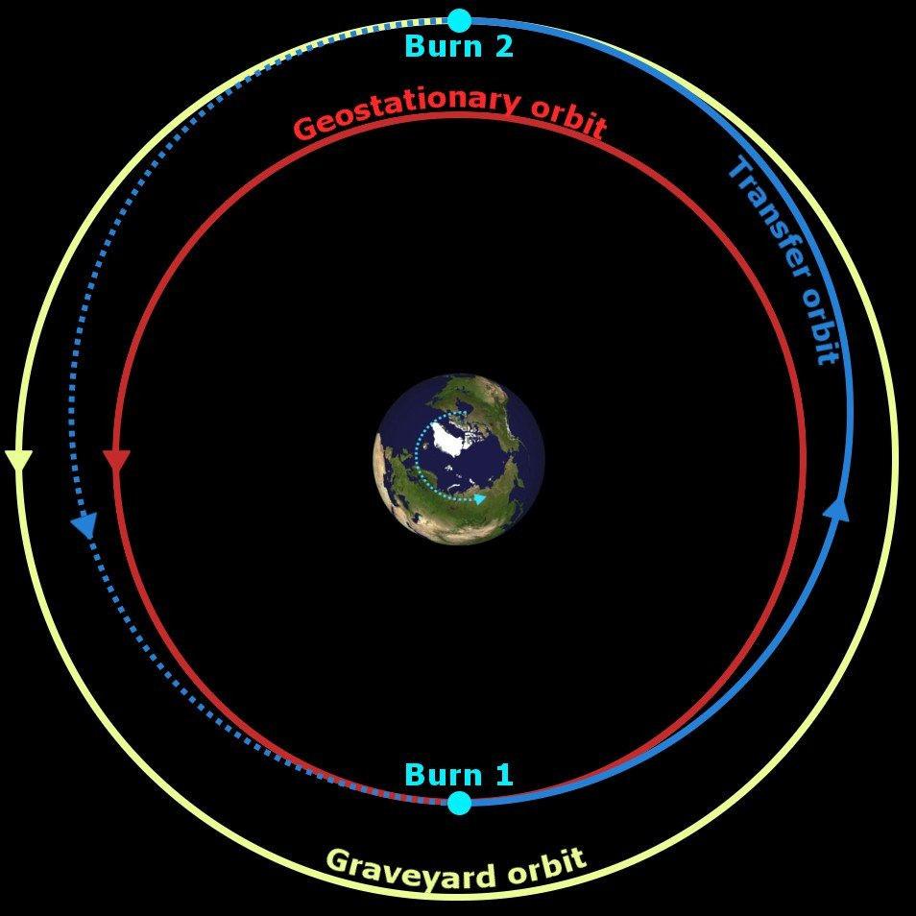
GEO GRAVEYARD

Slide 13
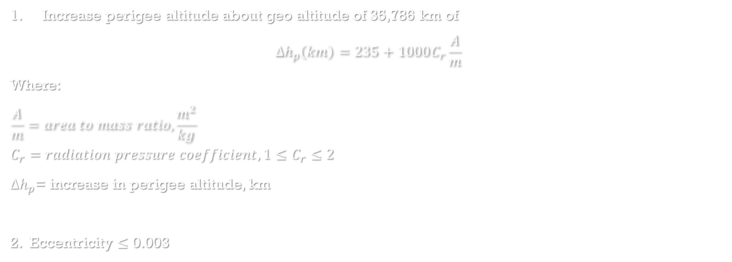
Two conditions
Increase perigee altitude about geo altitude of 35,786 km of
$$∆h_{p}\left(km\right)=235+1000C_{r}\frac{A}{m}$$
Where:
$$\frac{A}{m}=area to mass ratio, \frac{m^{2}}{kg}$$
$$C_{r}=radiation pressure coefficient, 1≤C_{r}≤2$$
$∆h_{p}$= increase in perigee altitude, km
2. Eccentricity $≤$ 0.003

Slide 14
WHAT SHOULD SATELLITE PROVIDERS DO?

Slide 15
WHAT SHOULD SATELLITE PROVIDERS DO?

